Slide 1

DIETARY FIBER -ANGULAR PROJECT
Aluru Dhileep Kumar
19001178

Slide 2

Introduction
Dietary fiber plays a crucial role in supporting overall health and well-being. Fiber acts as a prebiotic, providing nourishment for beneficial bacteria in the gut. This promotes a healthy balance of gut microbiota, which is associated with various aspects of health, including immune function and mental well-being.

Slide 3
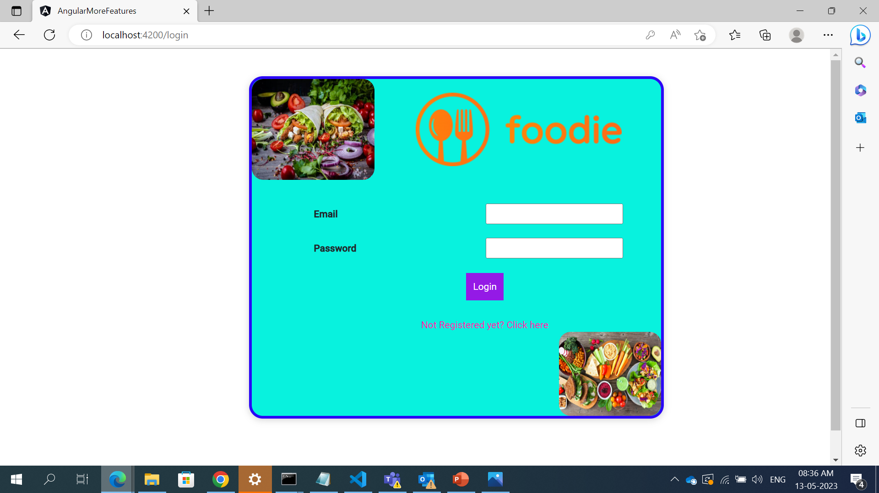
LOGIN WINDOW
3
Functions
Sign in
Sign UP
Concepts
Lazy loading
Validation

Slide 4
USER-LOGIN

Slide 5
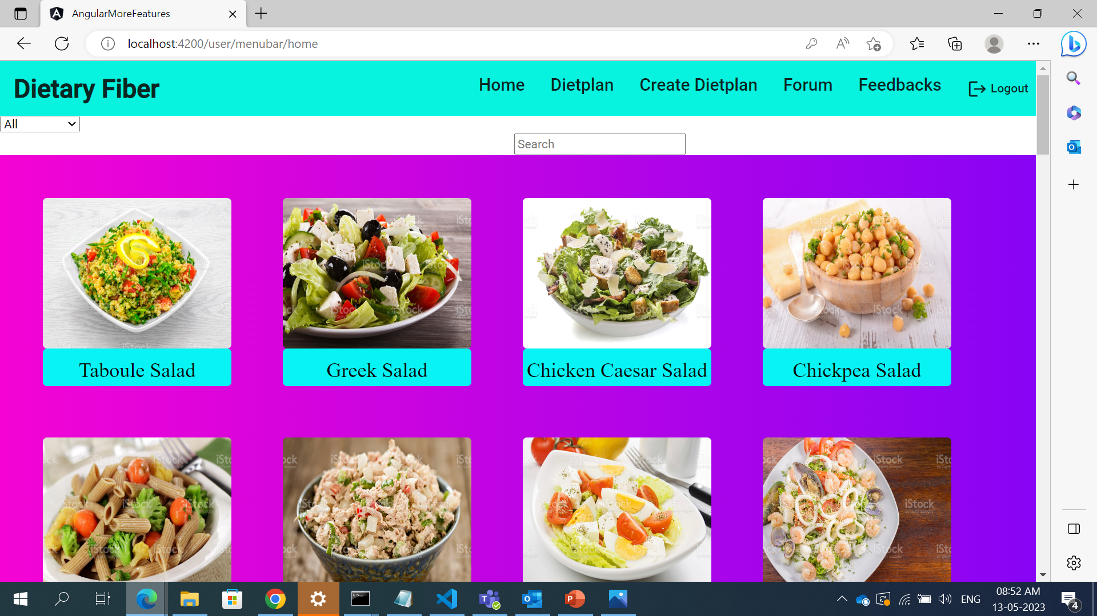

Slide 6
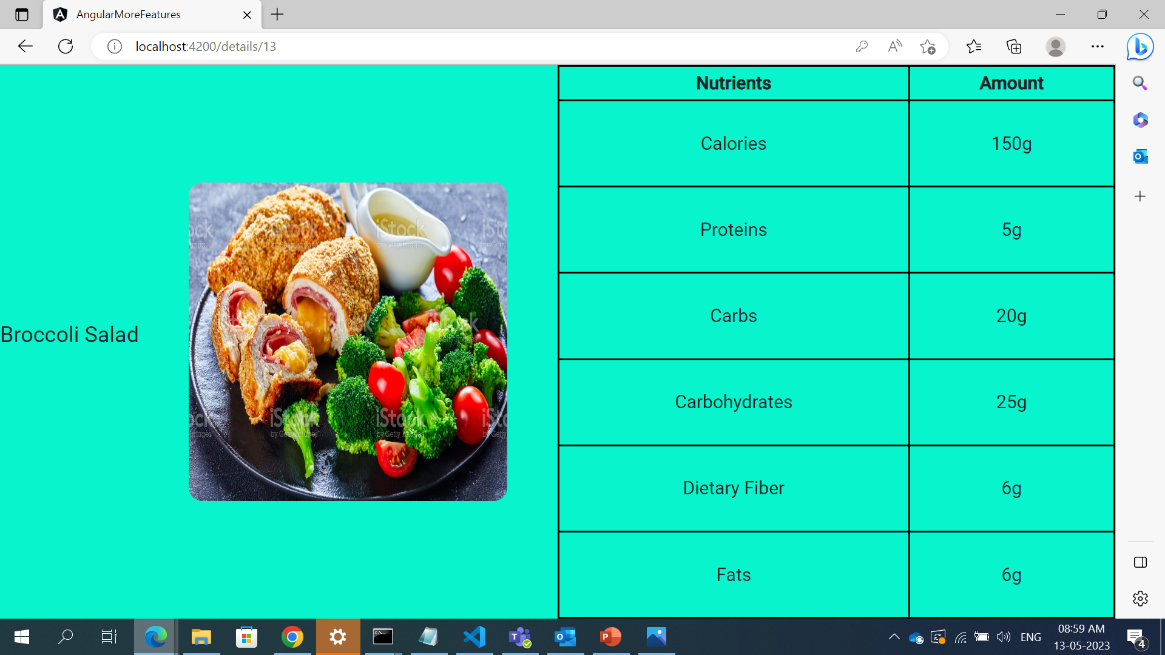
PRODUCT-DETAILS

Slide 7
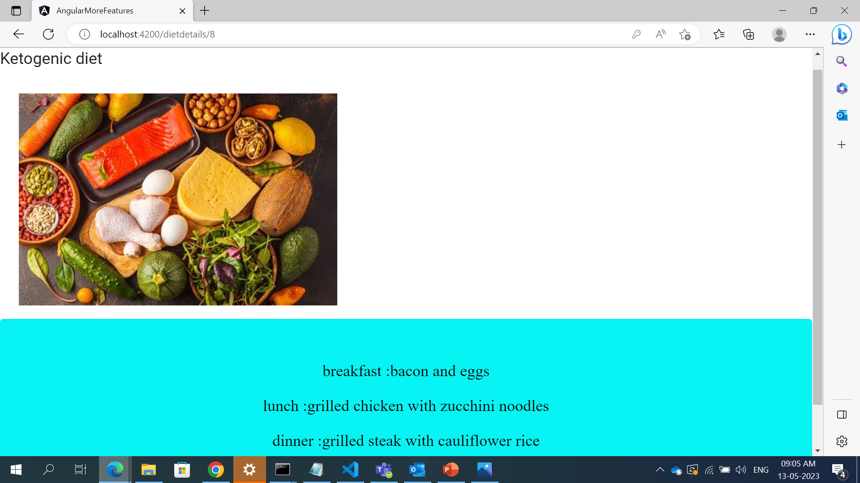
DIET-PLAN DETAILS

Slide 8
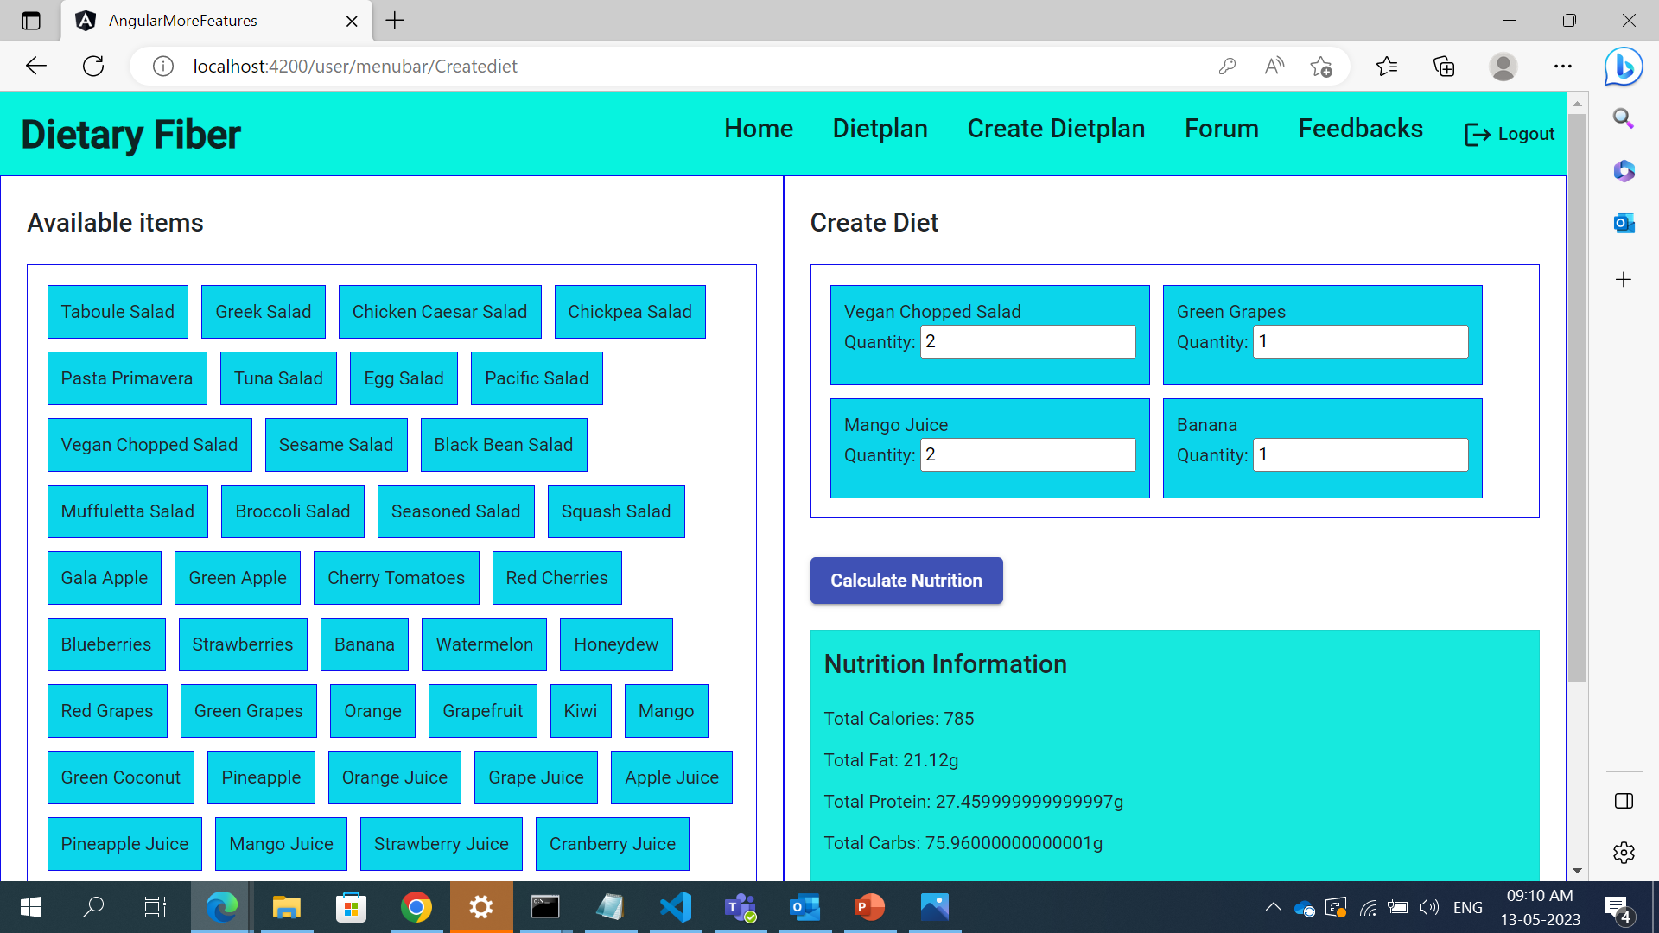
CREATE YOUR OWN-DIET PLAN

Slide 9
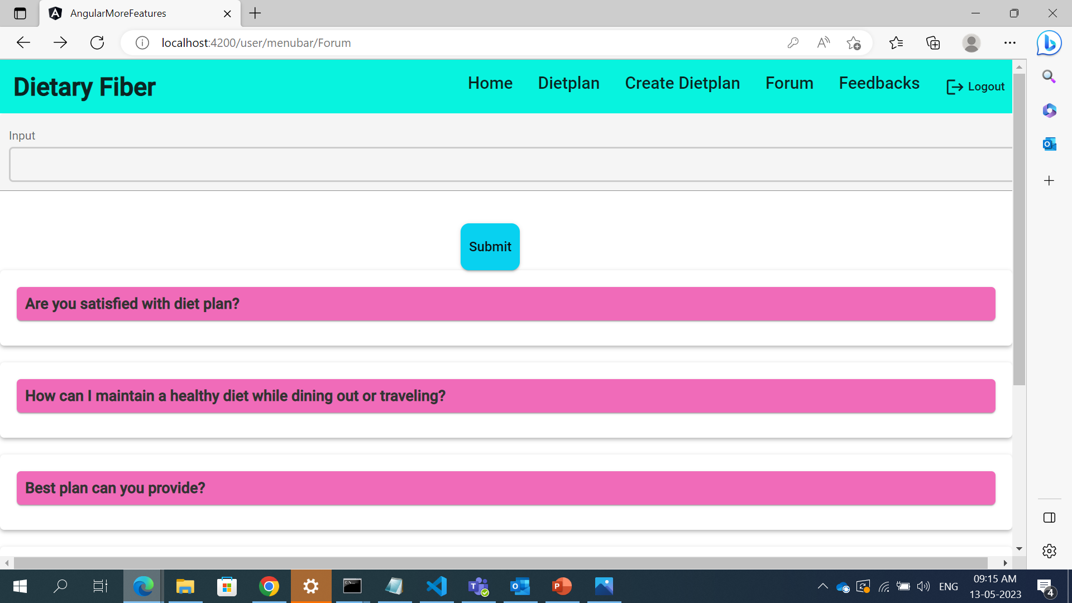
FORUM

Slide 10
ADMIN-LOGIN

Slide 11
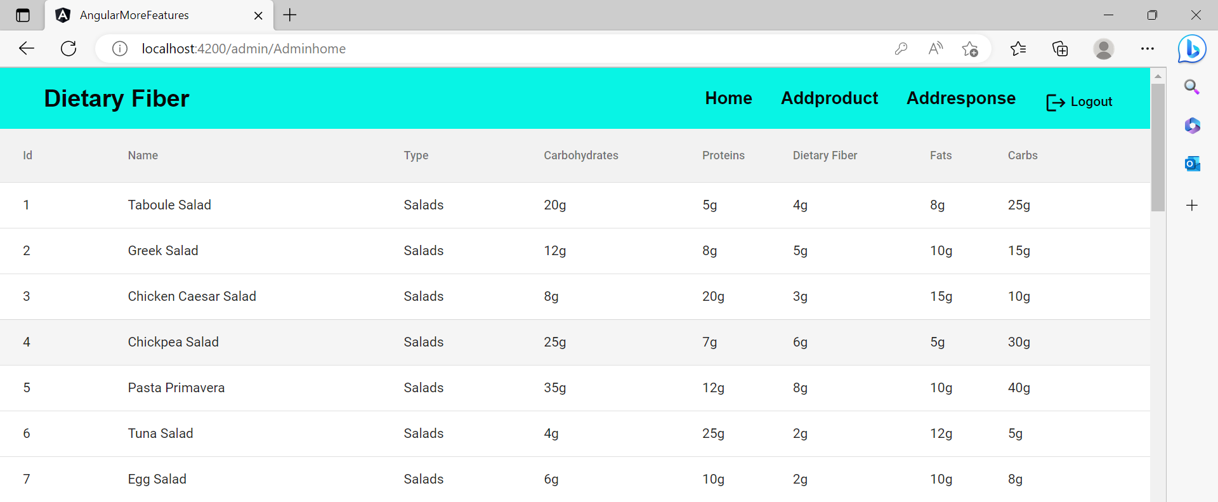
PRODUCT DETAILS IN TABULAR FORMAT

Slide 12
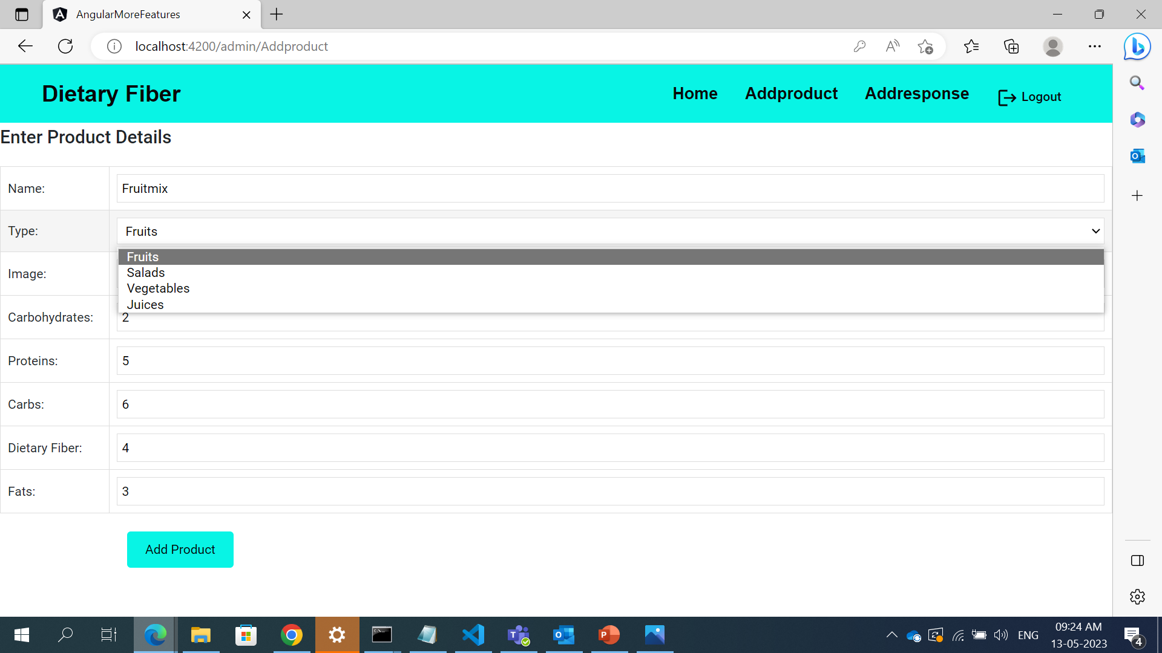
ADDING NEW PRODUCT

Slide 13
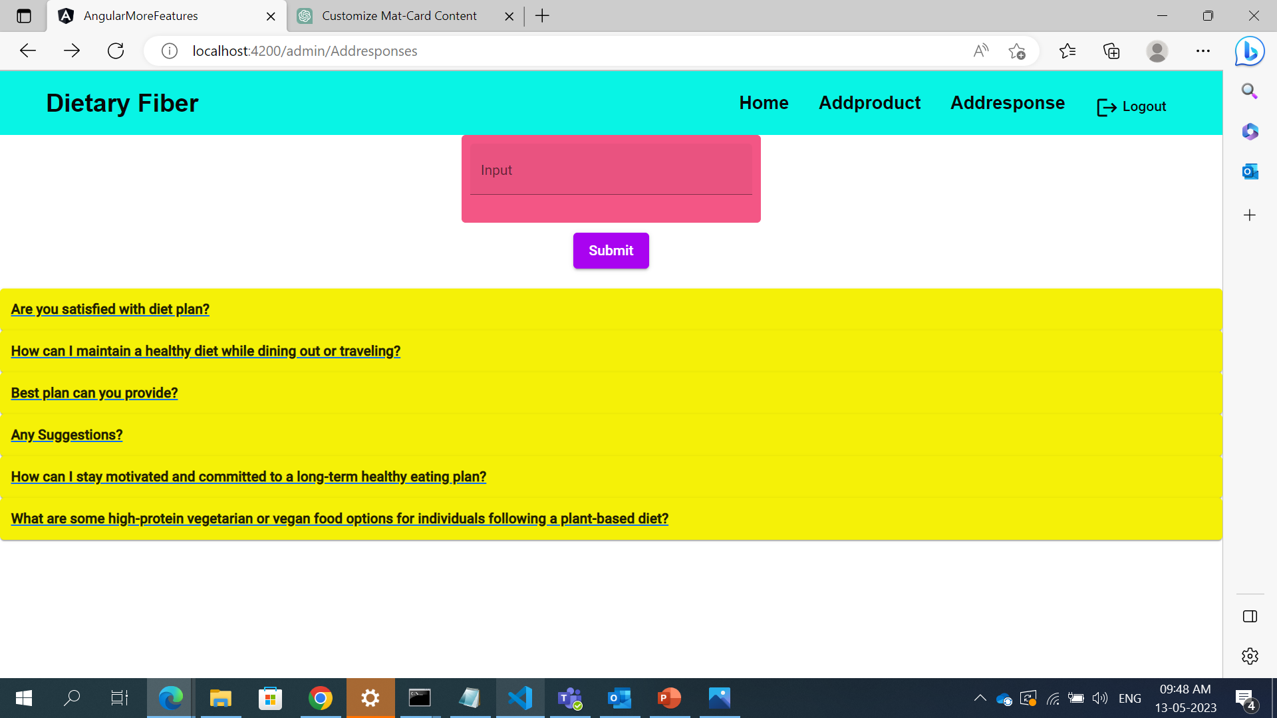
ADDING RESPONSES

Slide 14
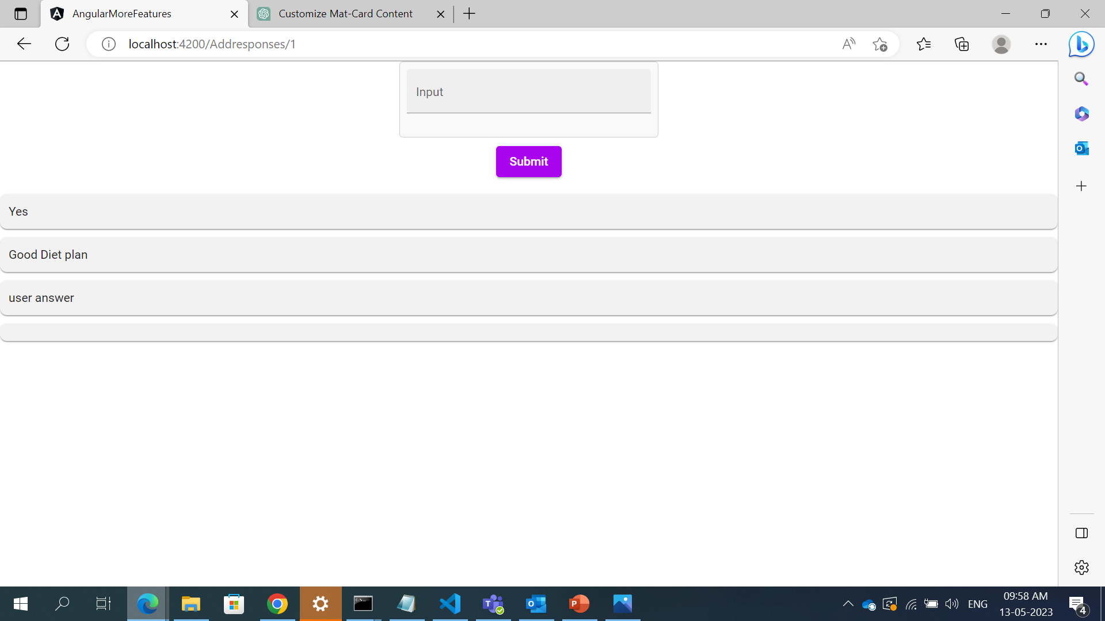
RESPONDING THROUGH ADMIN END

Slide 15




Thank you

